Slide 1
Human Action Adverb Recognition: ADHA Dataset And A Three-stream Hybrid Model
Shanghai Jiao Tong University

Slide 2
Content
Introduction
ADHA dataset
Three-stream Hybrid Model
Experiments
Conclusions

Slide 3
Introduction
Object detection/recognition (noun)
Action recognition (verb)
Attribute learning (adjective)
Adverb

Slide 4
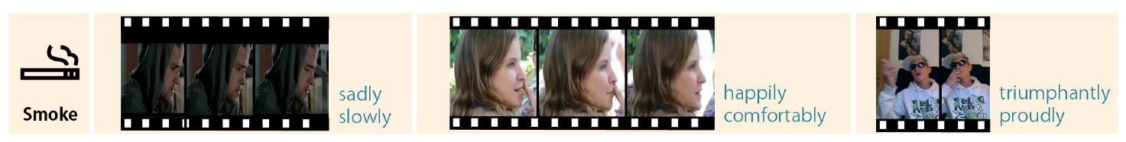
Contribution
Adverbs Describing Human Actions (ADHA) Dataset
11 distinct human action adverbs (HAAs) per action
adverb categories based on semantics rather than words
multi-labeled
each video labeled by three annotators

Slide 5
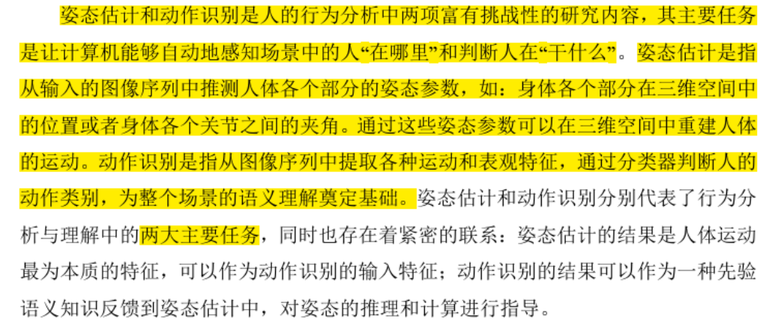
Contribution
benchmark several current action recognition, pose estimation, and image captioning models on ADHA
propose a hybrid model using pose, expression, optical flow and RGB information

Slide 6
Constructing ADHA
Action Collection
previous action dataset(eg:UCF101) → remove adverb-needless actions
rank action categories by the percentage of being described by at least one adverb
choose top 32 actions in the shortlist
{brush hair, chew, clap, climb stairs, dive, draw sword, drink, eat, fall floor, hit, hug, kick, kiss, pick, pour, pullup, punch, push, run, shake hands, shoot bow, shoot gun, sit, smoke, stand, swing baseball, sword, sword exercise, talk, throw, walk, wave}

Slide 7
Adverb Collection
Corpus of Contemporary American English (COCA)
choose 113 adverbs 51 adverbs left
user study：adverb set cover 98% of what they want to express about the video
Adverb-action Pair Collection
N-gram data¹ candidates
350 adverb-action pairs
remove synonyms
Notes:
1. https://www.ngrams.info/

Slide 8
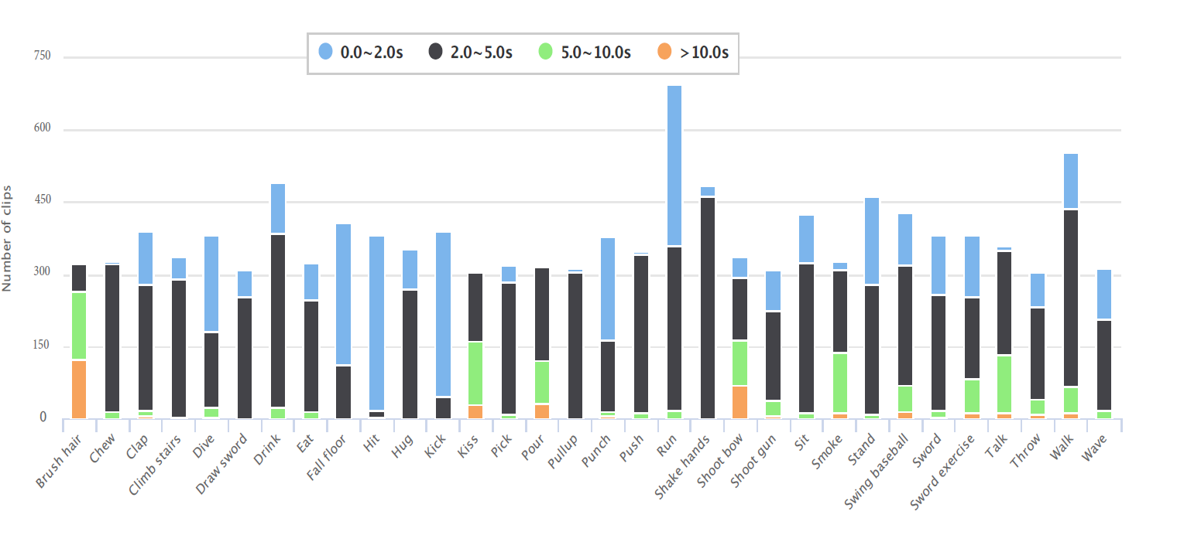
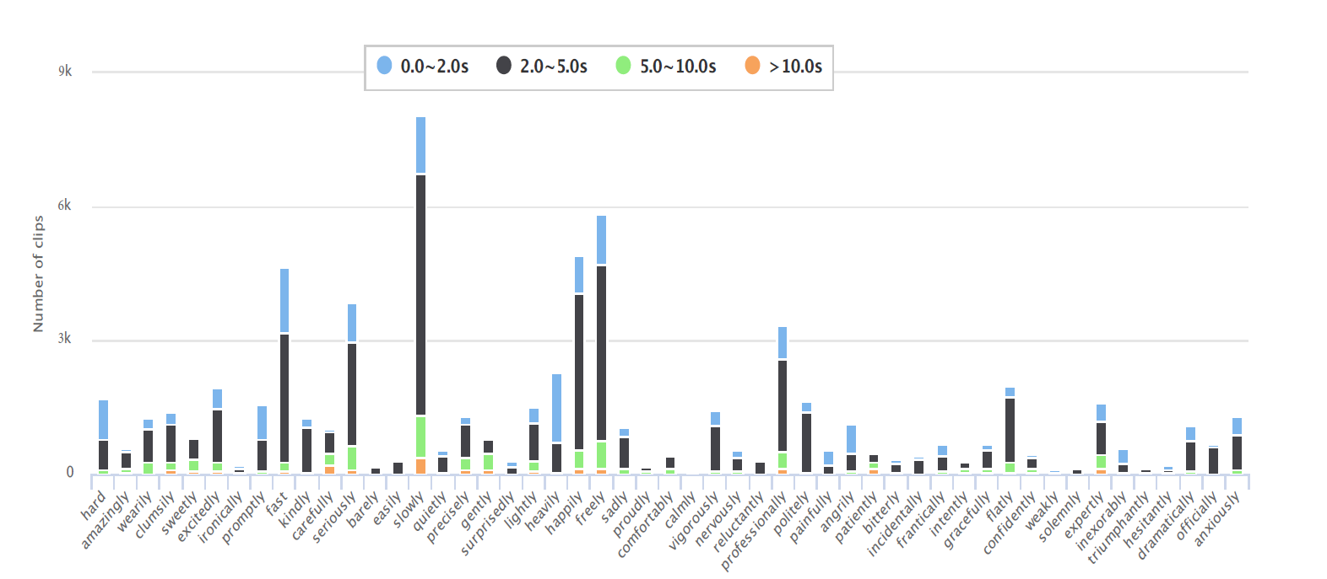
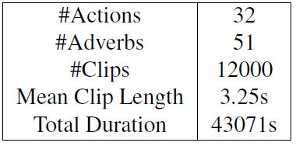
Video Collection and Annotation
Video Collection：YouTube + existing action datasets
Human Instance Annotation： semi-automatic annotation framework

Slide 9
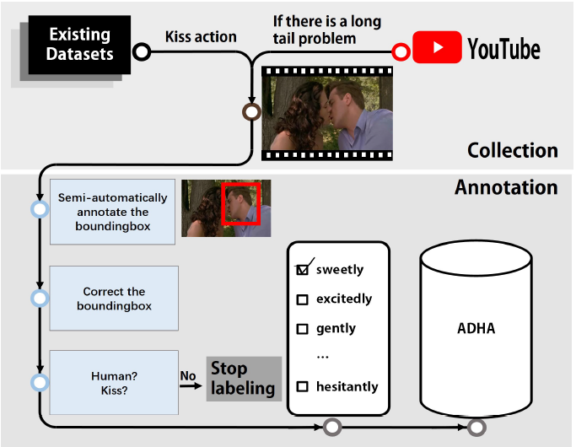
Pipeline for collecting and annotating the videos
Notes:
视觉目标跟踪可定义为估计物体围绕一个场景运动时在图像平面中的轨迹，即一个跟踪系统给同一个视频中不同帧的跟踪目标分配相一致的标签。

Slide 10
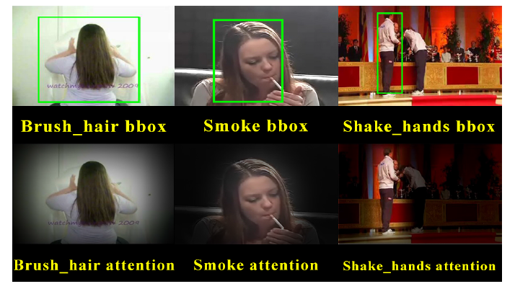

Attention Mechanism
lower the brightness beyond the boundingbox
smoothing process：
$σ$：the value to lower the brightness
B：the attention area
c：the center of B
a：the raw value of the point p
then the decayed value of p can be written as
$Max(0,a−|p−c|I(p∉B)×σ)$

Slide 11
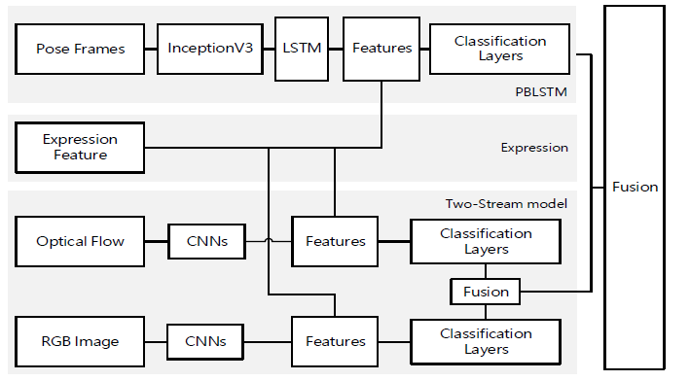
The Three-stream Hybrid Model

Slide 12
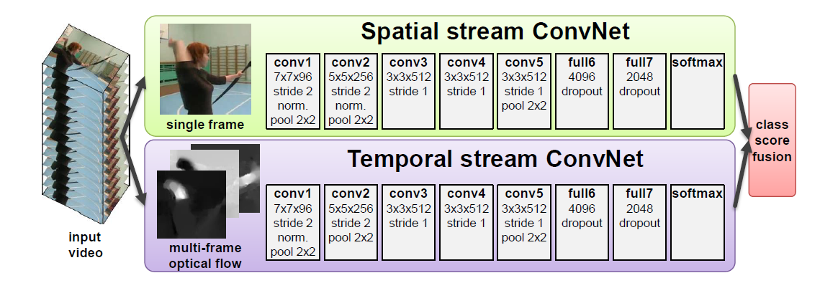
Two-Stream Sub-Model
spatial stream： RGB information
temporal(motion) stream： optical flow information(Gunnar Farneback algorithm)
Notes:
具体是参考另一篇文章中的这样一个架构做的，最后使用平均或线性SVM融合了softmax分数。

Slide 13
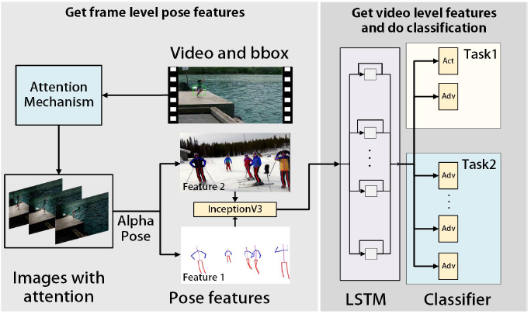
Pose Based LSTM Sub-model (PBLSTM)
AlphaPose： multi-person 2D pose estimation
inceptionV3：extract the feature maps of
the poses and get temporal irrelevant
features of each frame
LSTM： obtain global features
& do the recognition

Slide 14
Using Expression Knowledge & Fusion the Sub Models
Expression：Video-Based Emotion Recognition using CNN-RNN and C3D Hybrid Networks (EmotiW2016)
Fusion：
choose the best settings of each sub model & add the expression features
use average polling method to finally fuse them

Slide 15
Experiment Setup
Metric ：
mean average precision (mAP)
Hit@k
Evaluation：
If the person in the boundingbox is doing the specific action and the action matches the features of one candidate adverb, then, this is a positive sample. If not, then this is a negative sample for that adverb.
80% of the dataset as training set and the remaining as test set
2 tasks：one is given a video then recognizing the action and adverbs (task 1); the other is given a video and its action categories then recognizing the adverbs (task 2)

Slide 16
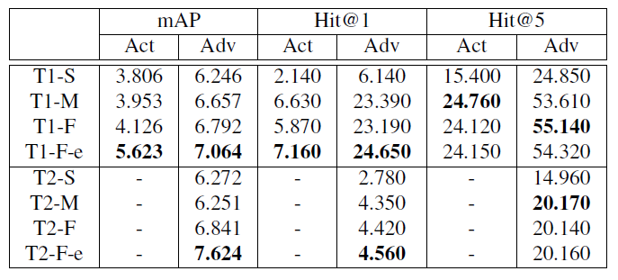
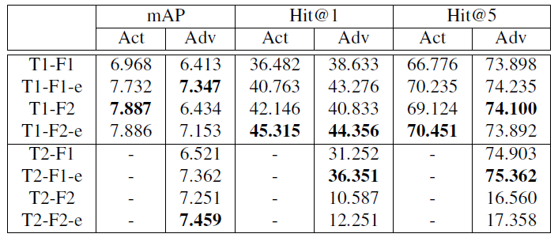
Result and Discussion(1)
Two-stream Model results
PBLSTM results
Notes:
T1表示任务1，S表示只利用空间特征，M表示只利用时序特征，F表示融合了二者的特征，e表示加入了表情特征
F1表示只用关键点信息，F2表示结合关键点信息和背景信息，e表示加入了表情特征

Slide 17
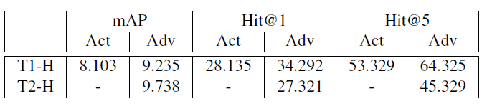
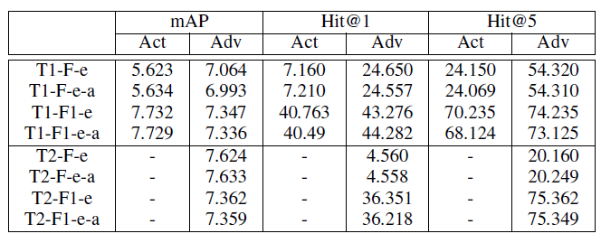
Result and Discussion(2)
Hybrid models results
Results with and without human correction

Slide 18
Conclusions
We established the first benchmark for recognizing human action adverbs: ADHA.
With ADHA, we benchmarked several outstanding action recognition models.
Moreover, we propose a hybrid model using RGB, optical flow, pose and expression knowledge.

Slide 19
谢谢！

